Slide 1
Don’t Make ME Think.
User Experience Design 101

Slide 2
How we see things affects our usage

Slide 3

We Perceive what we expect
If you were a REAL ESTATE manager designing plans for a new campus building,
- what would you see below?
Campus Building Lay out

Slide 4
We Perceive what we expect
If you were an ADVERTISING manager instead, and you were discussing a new billboard , to be placed around the country – what would you see?
Word

Slide 5
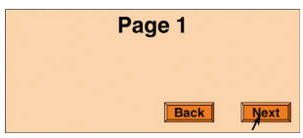

Slide 6
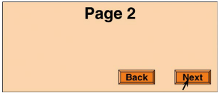

Slide 7
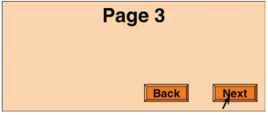

Slide 8
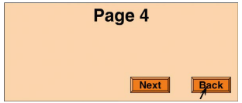

Slide 9
Where was the next button on page 4? (LEFT or RIGHT)

Slide 10
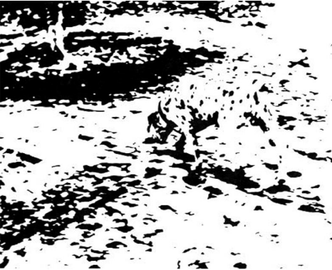
What do you see?
After knowing what the picture was, can you go back to seeing it as an image of random dots?
Dalmatian Dog Sniffing the Ground Near a Tree

Slide 11
We Perceive what we expect
Experience (CONTEXT) can bias other types of perception like sentence comprehension.
New Vaccine Contains Rabies
How can other people interpret this differently?

Slide 12


Perception BIASED BY context
The same character is perceived differently depending on surrounding letters.

Slide 13
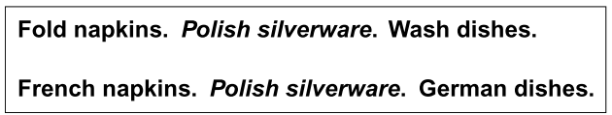
Perception BIASED BY context
Same phrase perceived depending on the list it appears in.
USER FACT Visual perception, reading and recognition work together in the human brain. How we organize elements in the interface can affect WHAT the user will see and understand.

Slide 14
GOALS AFFECT BY Perception
Let’s try a simple test: Find the Scissors in the picture in the next slide.
Without looking back to the picture, can you tell whether there is a screwdriver in the toolbox too?

Slide 15
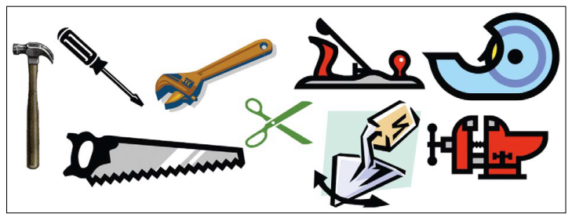

Slide 16
GOALS AFFECT BY Perception
USER FACT When users navigate through software or website, they don’t READ carefully.
Another test: Suppose you were asked to print out a map of the campus showing the computer science department, how’d you find it in the website shown in the next slide?

Slide 17
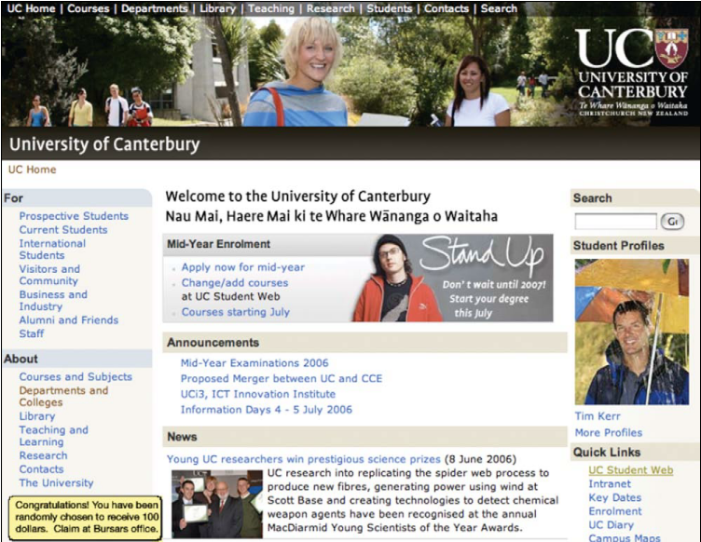
Did you notice this?

Slide 18
We Perceive what we expect
DESIGN IMPLICATIONS
Avoid Ambiguity.
Make sure all the users interpret the display in the same way. If ambiguity is inevitable, rely on standards or conventions.
Be Consistent.
Place information and controls in consistent locations. Controls and data that serves the same function should be placed in same position. Color, text fonts, and other visual features consistency help users

Slide 19
We Perceive what we expect
DESIGN IMPLICATIONS
Understand the goals.
Users have goals when they use the system. These goals strongly influence what they perceive.
When designing interfaces, at every point in an interaction, the information the user needs is available, prominent and maps clearly to a possible user goal.

Slide 20

Visual Structure: Gestalt Principles
1 – Proximity
Distance between objects affects our perception of how objects are organized or related.

Slide 21
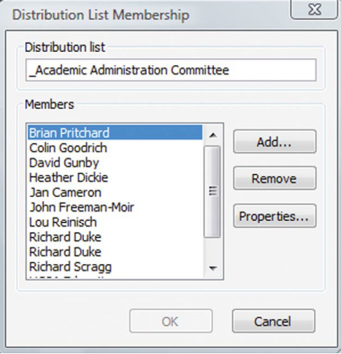
Visual Structure: Gestalt Principles
1 – Proximity
Distance between objects affects our perception of how objects are organized or related.

Slide 22

Visual Structure: Gestalt Principles
2 – Similarity
Objects that look similar appear grouped, all other things being equal.

Slide 23
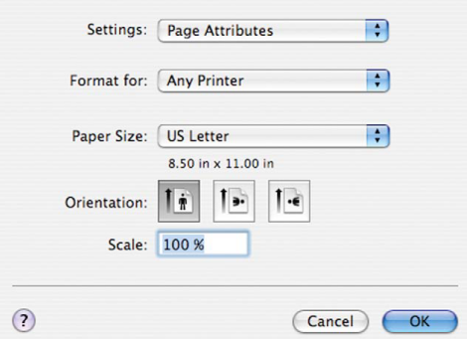
Visual Structure: Gestalt Principles
2 – Similarity
Objects that look similar appear grouped, all other things being equal.

Slide 24

Visual Structure: Gestalt Principles
3– Continuity
Our visual system tend to resolve ambiguity or fill in missing data in such a way to perceive whole objects. We see forms than segments.

Slide 25
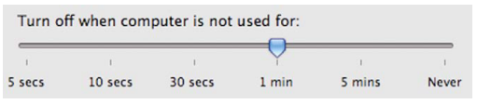
Visual Structure: Gestalt Principles
3– Continuity
Our visual system tend to resolve ambiguity or fill in missing data in such a way to perceive whole objects. We see forms than segments.

Slide 26

Visual Structure: Gestalt Principles
4– Closure
Our visual system automatically tries to close open figures so that they are perceived as whole objects rather than separate pieces.

Slide 27

Visual Structure: Gestalt Principles
4– Closure
Our visual system automatically tries to close open figures so that they are perceived as whole objects rather than separate pieces.

Slide 28

Visual Structure: Gestalt Principles
5 - Symmetry
We tend to parse complex scenes in a way that reduces complexity. Our vision usually organizes and interprets data so as to simplify it and give symmetry.

Slide 29

Visual Structure: Gestalt Principles
5 - Symmetry
2 Dimensional Images can be seen as 3 dimensional scenes.

Slide 30

Visual Structure: Gestalt Principles
6 – Figure/Ground
Our mind separates the field into the figure (foreground) and ground (background). The foreground consists of objects of your primary attention and background is everything else.

Slide 31

Visual Structure: Gestalt Principles
6 – Figure/Ground
Our perception is influenced by scene characteristics and our focus of attention.

Slide 32
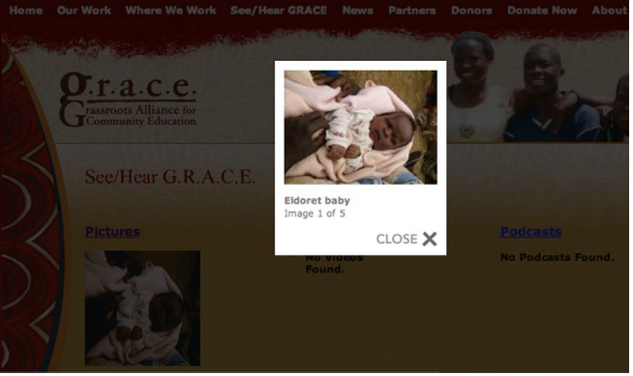
Visual Structure: Gestalt Principles
6 – Figure/Ground
How it is applied in software UI

Slide 33
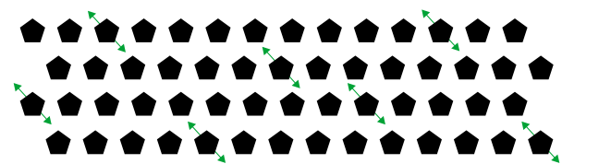
Visual Structure: Gestalt Principles
7 – Common Fate (for moving objects)
Objects that move together are perceived as grouped or related.

Slide 34
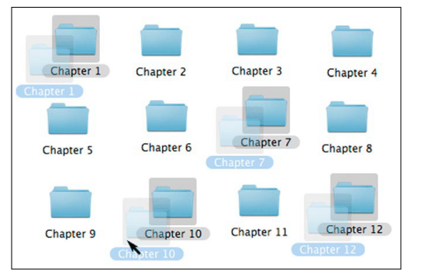
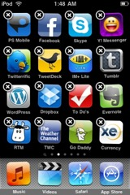
Visual Structure: Gestalt Principles
7 – Common Fate (for moving objects)
Objects that move together are perceived as grouped or related.

Slide 35
Our VISION is optimized to see structure
GESTALT Principles:
PROXIMITY
SIMILARITY
CONTINUITY
CLOSURE
SYMMETRY
FIGURE/GROUND
COMMON FATE
DESIGN IMPLICATIONS
Unintended visual relationships can be implied by a design. When designing, view your interface with gestalt principles in mind to see if your design suggests any relationships between elements that you do not intend.

Slide 36
We SEEK and USE Visual Structure
You are booked on United flight 237, which departs from
Auckland at 14:30 on Tuesday 15 Oct and arrives at San
Francisco at 11:40 on Tuesday 15 Oct.
Flight: United 237, Auckland San Francisco
Depart: 14:30 Tue 15 Oct
Arrive: 11:40 Tue 15 Oct
Which is easier to read?

Slide 37
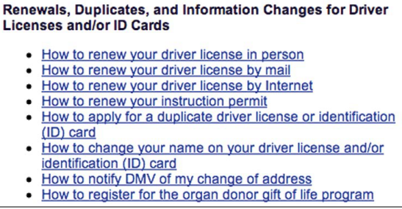
We SEEK and USE Visual Structure
No structure

Slide 38
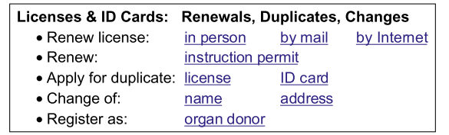
We SEEK and USE Visual Structure
With structure

Slide 39
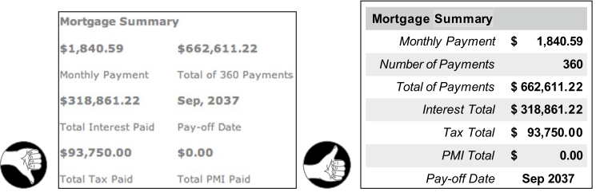
We SEEK and USE Visual Structure

Slide 40
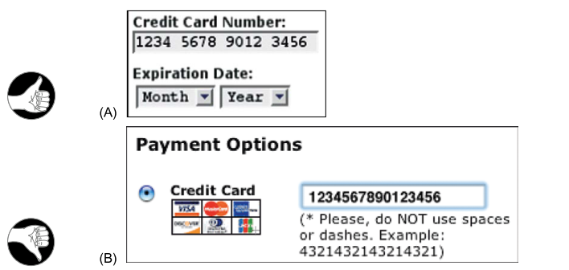
We SEEK and USE Visual Structure

Slide 41
Visual hierarchy lets people FOCUS ON relevant information
DESIGN IMPLICATIONS
Organize and prioritize the contents of a page/screen by using size, prominence and content relationships.
Size – more important a text is, the bigger the font size
Prominence- the more important a text is, the higher up the page it should be placed. This is to minimize scrolling and to let the users find the info quickly.
Content Relationships – Group similar content/commands types by displaying it in a similar visual style or in a clearly defined area.

Slide 42
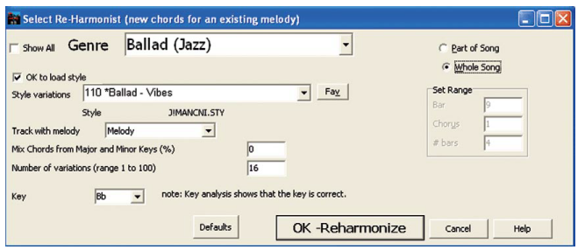
Visual hierarchy lets people FOCUS ON relevant information

Slide 43
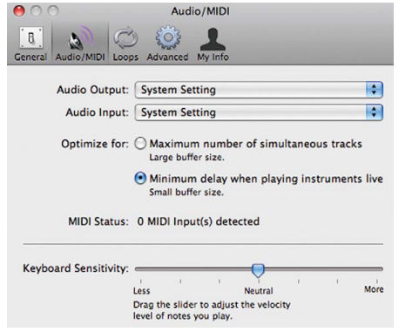
Visual hierarchy lets people FOCUS ON relevant information

Slide 44

Vision is optimized for edge contrast, not brightness
How many shades of green do you see?

Slide 45
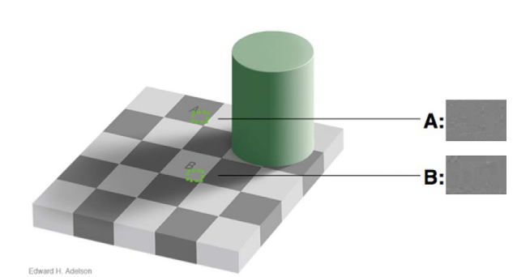
Vision is optimized for edge contrast, not brightness
How many shades of green do you see?

Slide 46




How Colors are presented is important
PALENESS – The paler (less saturated) two colors are, the harder it is to tell them apart.
COLOR PATCH SIZE– The smaller or thinner objects are, the harder it is to distinguish their colors. (e.g. Text is often thin, so exact color of text is difficult to determine.
SEPARATION – The more separated color patches are, the more difficult it is to distinguish their colors..

Slide 47

Using Color
DESIGN IMPLICATIONS
Distinguish colors by saturation and brightness as well as hue. Contrast between colors should be HIGH. To see the difference, test it in grayscale.
Use distinctive colors (black, white, red, green, yellow, violet)
Avoid color pairs that color-blind people cannot distinguish. (use Vischeck.com for more info)
Color should be supported by other cues (text, icons)
Separate “strong” opposing colors.

Slide 48
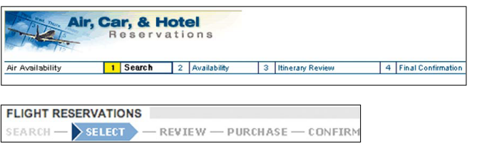
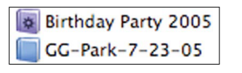
USING Colors
Good Examples

Slide 49
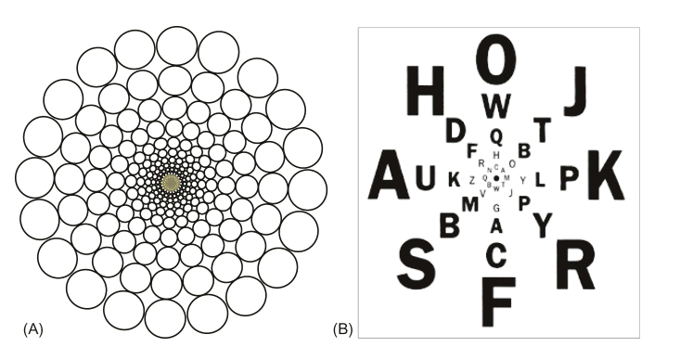
Our Peripheral VISION is poor
Resolution of our visual field is high in the center but much lower at the edges.

Slide 50
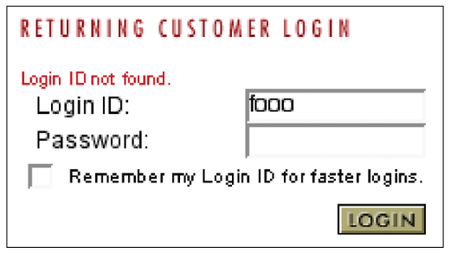
Our Peripheral VISION is poor
Some users report that they did not notice the Login ID not found message. Why is that?

Slide 51
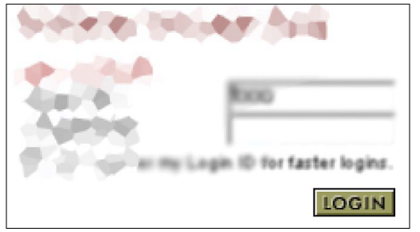
Our Peripheral VISION is poor
This is how our eye see it when we focus on LOGIN button.
*Unbelievable but true. Your brain’s just amazing in filling in the gaps.

Slide 52
Common methods of making messages visible
Put it where users are looking.
Mark the error.
Use an error symbol.
Reserve red for errors.

Slide 53
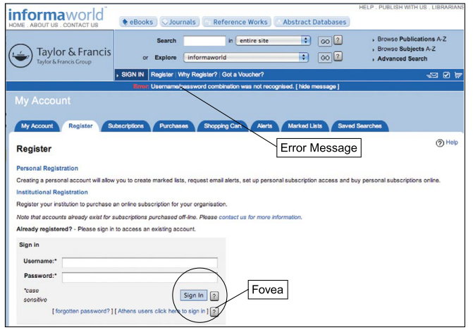
Common methods of making messages visible

Slide 54
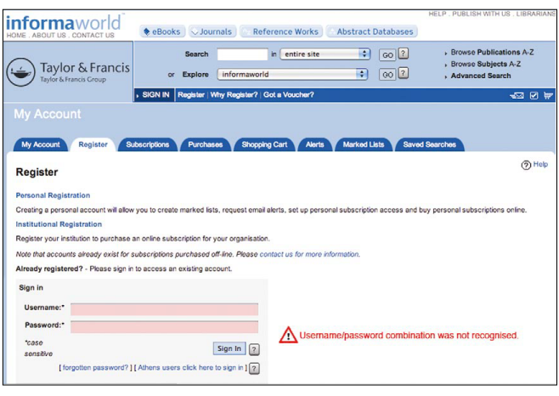
Common methods of making messages visible

Slide 55
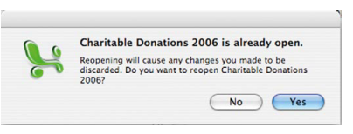
Message: How to make users notice
Use degree of modality
Non-modal – allows user to ignore and continue work
Application Modal – block any further work in the application but allow other software in their computer
System Modal – blocks any user action until dialog has been resolved
Use sound
Flash or wiggle

Slide 56
How we learn to use the software

Slide 57
AttentiOn is limited; memory is imperfect
Memory Test
Get one blank sheet of paper after this slide.

Slide 58
3 8 4 7 5 3 9

Slide 59
Ready?

Slide 60
3 1 4 1 5 9 2

Slide 61
Ready?

Slide 62
1 3 5 7 9 11 13

Slide 63
Ready?

Slide 64
Town river corn string car shovel

Slide 65
Ready?

Slide 66
What is the meaning of life

Slide 67
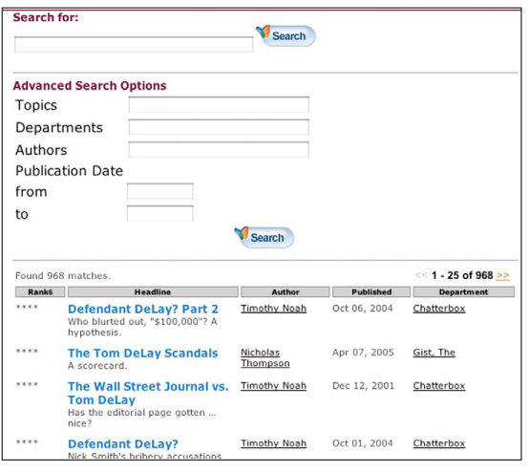
Short Term Memory is LIMITED and VOLATILE
What’s wrong with this example?

Slide 68
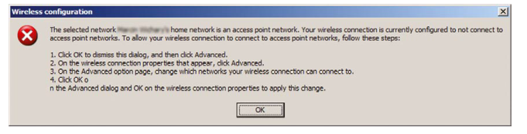
Short Term Memory is LIMITED and VOLATILE
What’s wrong with this example?

Slide 69
LONG TERM Memory
Error Prone
Weighted by Emotions
Retroactively Alterable
People need tools to augment it.

Slide 70
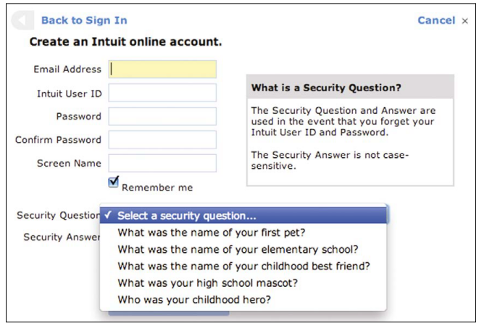
Implications to ui design
What’s wrong with this example?

Slide 71
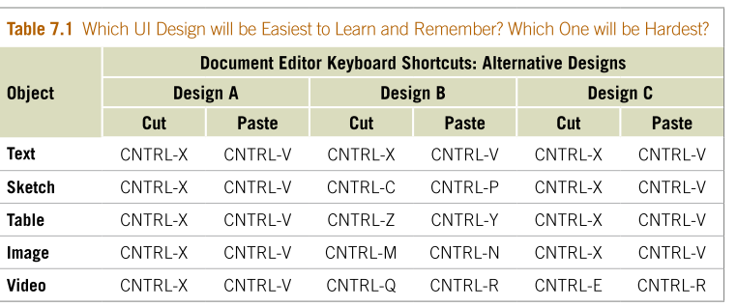
Long TERM MEMORY IMPLICATIONS
What do we mean by “learn”?

Slide 72
WE focus on goals not tools
We need external aids to keep track of what we are doing.
Counting Objects
Reading Books
Checklists

Slide 73
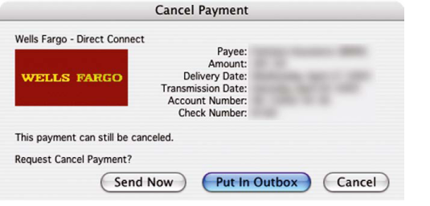
We follow the scent of information toward the goal
What is wrong here?

Slide 74
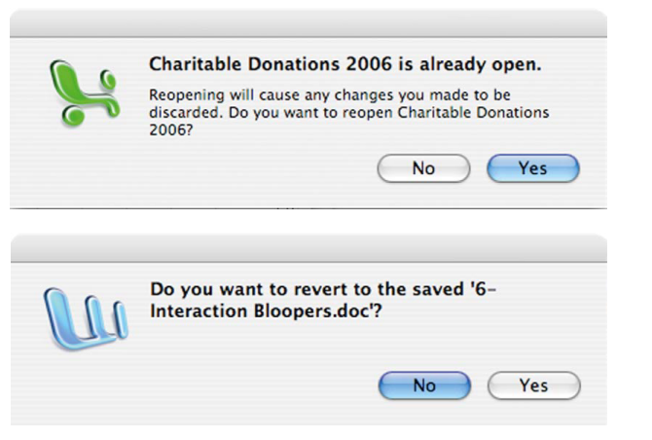
We follow the scent of information toward the goal
Another example

Slide 75
We prefer familiar PATHS
Sometimes mindlessness trumps keystrokes.
Allowing users to become productive quickly and reducing their need to problem-solve is more important than saving keystrokes.
Guide users to the best paths.
Software should provide clear information scent.
Help experienced users speed up.
Make it easy for users to switch to faster paths after they have gained experience.

Slide 76
GOAL, EXECUTE, EVALUATE
GOAL
Provide clear paths – including initial steps for the user goals that the software is intended to support.
EXECUTE
Objects, information, actions should be based on the task rather than the implementation. Provide scent at choice points that guide users to their goal.
EVALUATE
Provide feedback and status information to show users their progress toward the goal. Allow users to back out of tasks that didn’t take them to their goal.

Slide 77
Examples: People forget loose ends of task
BAD: Turn car headlights OFF after arrival, to prevent draining the battery.
GOOD: Cards already turn turn-signals OFF after a turn.

Slide 78
RECOGNITION IS EASY; RECALL IS HARD
See and Choose is easier than recall and type.
Use pictures where possible to convey function.
The larger the number of people (or the more frequent) who will use a function, the more visible the function should be.
Use visual cues to let users recognize where they are.

Slide 79
Problem solving and calculation are hard
Tell users explicitly and exactly what they need to know.
Don’t make users diagnose system problems.
Minimize the number and complexity o settings
Let people use perception than calculation.
Make it familiar.

Slide 80
How do we learn? OPERATIONS
Focus on task
Simple
Consistent

